Slide 1

Teddy
Tommy Braccia, Danny Tran, Emma Hubka
Notes:
Welcome to our presentation. My name is Emma and my teammates names are Tommy and Danny. Today we will be telling you about the application we made: Teddy. I do want to give a disclaimer that our presentation will talk about suicide.

Slide 2
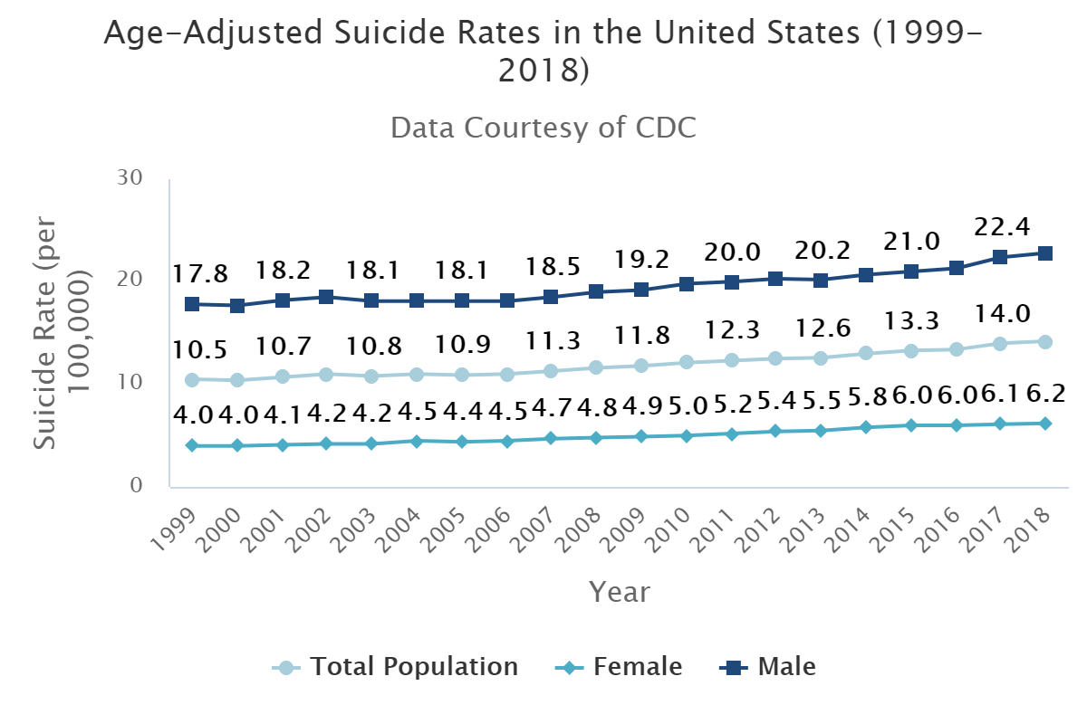
The Problem Continued
In 2019,
47,511 people died of sucide
14.5 deaths per 100,000 population
Ranked 10th in cause of death
Source: National Institute of Mental Health
Notes:
As you can see in the chart, the number of suicides per year has been increasing since at least 1999
We want to see that number drop all the way to zero, so we decided to create Teddy
And I will now pass it off to Danny to tell you about what Teddy does

Slide 3
The Problem
In 2019,
47,511 people died of suicide
14.5 deaths per 100,000 population
Ranked 10th in cause of death
Source: National Vital Statistics System – Mortality Data (2019) via CDC WONDER
Notes:
The problem we identified for our project was the high number of suicides in the US
In 2019 alone 47,511 people died of sucide which is 14.5 deaths per 100,000 population
And suicide is ranked 10th in cause of death
We decided we wanted to create an application to help mitigate this problem to the best of our ability

Slide 4
Our Solution: Teddy
Teddy follows the health track
Teddy is a crisis intervention AI
Teddy helps overcomes issues associated with the Covid-19 pandemic
Teddy has the ability to help people at no cost, which allows crisis hotlines to help more individuals
Teddy is built to support small talk through Dialogflow for users to simply enjoy speaking to him
Notes:
Innovative that it doesn’t require a person to operate
Innovative that it gives people who do not want to talk to a person an outlet and a way to get help

Slide 5
Teddy is a Free Service
In order to create the most benefit in this world, we plan to make Teddy a free service available to everyone
Teddy is intended for two groups of people:
First, people who prefer not to talk to a person, but want support
Next, people who were not able to be immediately helped by a crisis intervention due to the rising wait times that can be attributed to COVID 19
Notes:
Innovative that it doesn’t require a person to operate
Innovative that it gives people who do not want to talk to a person an outlet and a way to get help

Slide 6
Demo

Slide 7
How We Did It
Technologies we used:
Dialogflow for the Chat Agent
Actions on Google
React Website with Bootstrap
NPM Keyword-Extractor
NPM Sentiment
Software engineering practices we focused on:
Usability
AAA WCAG Standards
Maintainability
Dependability
Scalability
Notes:
Talk about software engineering practices here

Slide 8
Major Sources
Research
https://suicidepreventionlifeline.org
https://suicidepreventionlifeline.org
https://www.crisistextline.org
https://www.healthline.com
https://www.vumc.org/health-wellness/news-resource-articles/what-do-i-say-when-someone-talking-about-suicide
https://www.csus.edu/indiv/b/brocks/workshops/district/3.sample%20suicide%20intervention%20script.pdf
https://www.womenshealthmag.com/life/a19930059/working-at-a-suicide-hotline/
https://www.washingtonpost.com/local/crisis-hotline-quarantine-coronavirus-mental-health/2020/03/23/632e2d7c-6abe-11ea-9923-57073adce27c_story.html
https://www.marketwatch.com/story/heres-what-happens-when-you-call-the-suicide-prevention-hotline-2018-09-14
https://www.crisiscenterbham.org/about-us/training-materials.html
http://www.suicide.org/how-to-talk-to-suicidal-callers.html
Creation
https://dialogflow.cloud.google.com/
https://create-react-app.dev/
https://developers.google.com/assistant
https://www.npmjs.com/package/sentiment
https://www.npmjs.com/package/keyword-extractor
https://www.npmjs.com/package/axios
https://dialogflow.cloud.ushakov.co/

Slide 9
Teddy

